Slide 1
SWE 632 Project Presentation
Team members:
Haren Akula – G01387760
Sagar Naidu Potana – G01355019
Mahaveerasaiteja Veluduti – G01354854

Slide 2
Paws & Tails
Our project is a front-end application for an online pet store.
The website offers a wide range of services catering to the needs of the pets in the form of pet care, vet consultations, pharmacy, pet products and much more.
The use cases we worked on include enabling the pet owners to search for their pet food and accessories efficiently, includes access to pet healthcare portal.
Link to the website: http://mason.gmu.edu/~mveludut/home.html

Slide 3
Why this website?
Pets are an integral part of many people's lives, and they deserve to be treated with the best care possible. With an increasing number of pet owners worldwide, there is a growing need for a convenient and efficient platform that provides all the necessary pet care products and services in one place.
Therefore, creating an e-commerce platform dedicated to pets (at present for dogs and cats, but will cater to other animals as well as and when deemed appropriate by the market) needs and accessories is essential to cater to this growing demand.
Keeping up with the current trends, providing virtual vet consultations along with pharmacy services is also essential.
Providing pet products is not enough, there is a void in the market for pet care, grooming and training service providers.

Slide 4
Stakeholders
Pet parents
Pets
Product manufacturers and wholesalers
Veterinary doctors
Pet Pharmacists
Pet care service providers

Slide 5
Our plan to tackle the problem
Provide a dedicated and one stop solution for pets.
We developed a user-friendly UI for our e-commerce platform. Our platform will have various components such as hyperlinks, buttons, and pop cards that provide clear affordance to the user, making it easy to navigate and find what they need.
We also incorporated signifiers such as color-changing buttons and interactive cards to make the platform engaging and visually appealing.
Additionally, we included an autocomplete feature in the FAQs to enable users to quickly search for answers.
Provide a design which is pleasant to view and navigate and, on a theme, like what interests' pets and pet parents.

Slide 6
Our goal for the website & target domain
The main goal is to have a one stop platform which will cater to almost every need a pet and a pet parent has, including but not limited to Pet food, Pet toys, Grooming products, and even veterinary consultation services.
Our main target is pet owners who are too busy or can’t go down to the pet store or pet owners in general who want access to best products for their pet needs in one place.
We also include the use case of access to pet healthcare portal, where the users can contact veterinary services post filling out a form describing their issue and needs.

Slide 7
Scenarios our website could prove helpful
A busy professional can easily order pet supplies online and have them delivered to their home if they don't have time to go to actual pet stores.
Online retailers make it simple for pet owners who reside in remote areas or areas with few pet businesses to buy a wide range of pet supplies.
Online pet store shopping is secure for pet owners who are worried about visiting physical pet stores while the COVID-19 epidemic is active.
Easy access to veterinary services to pet owners who have less knowledge about their pet healthcare needs and wants.
Quick and instant access to pet healthcare providers.
New pet parents who don’t have enough knowledge and awareness.

Slide 8
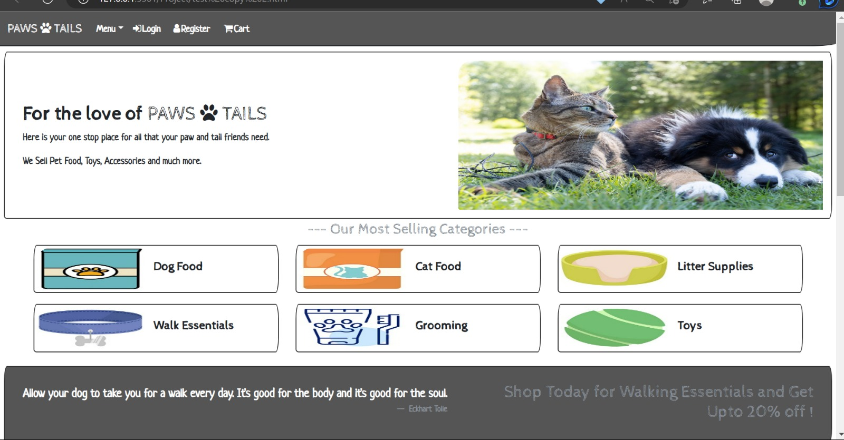
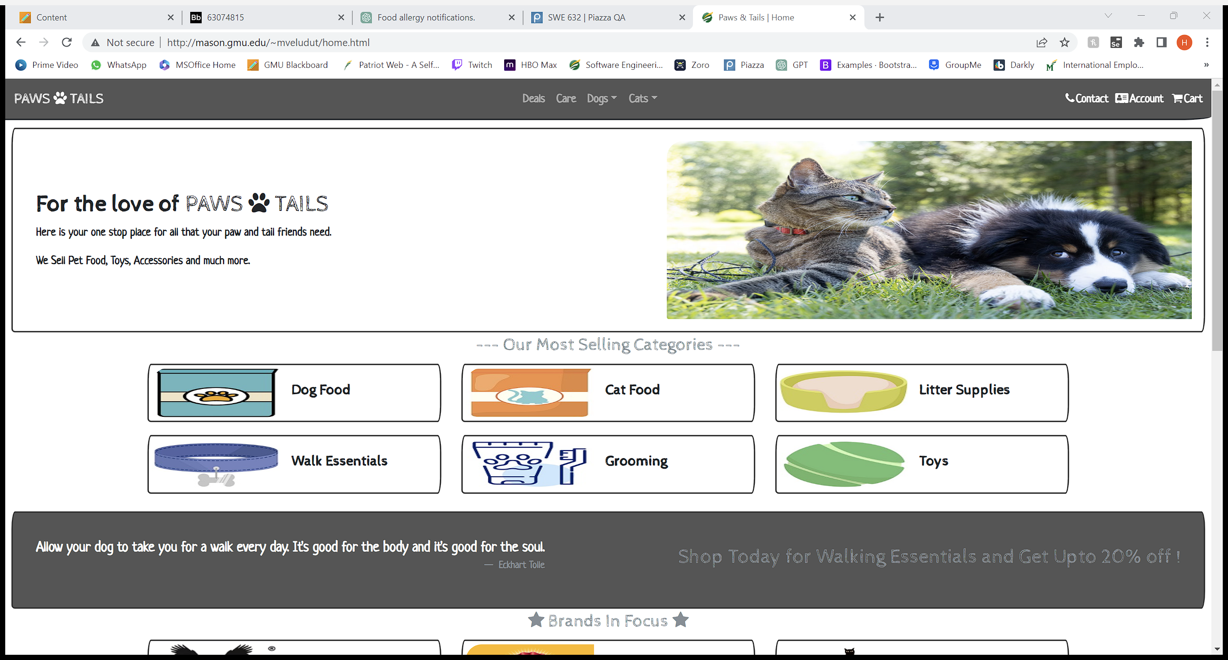
Usability heuristics and improvements
Heuristic 1 Visibility of components
In the earlier stages of the project the categories tab was tucked away into top-left and was kind of difficult to locate and often got mixed up with other navlinks, so in the next iteration we moved it to the center of the nav bar where it’s easier and faster to locate and pushed some of them to the right end. Doing so we have a clean navbar.

Slide 9
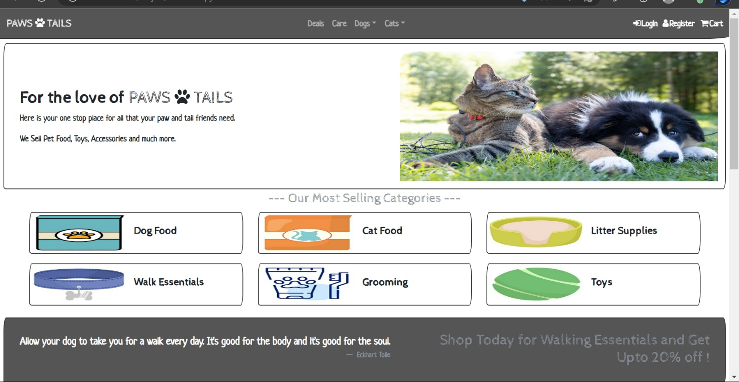
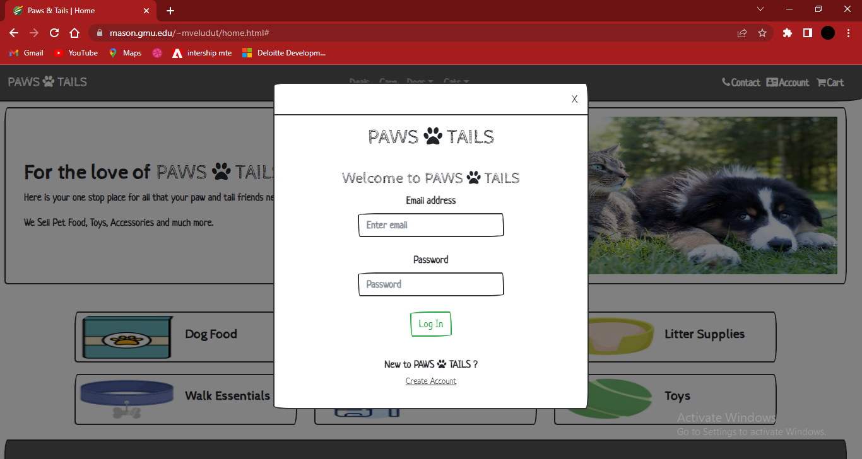
Usability heuristics and improvements cont.
Heuristic 2 Consistency and standards
When we first made the user Registration, we directly included it the NAV Bar. User was able to view register option even after logging in. Later it was changed to login form because of the user Consistency and standards. And the register option was provided in the login as an alternative to sign in. (as per industry standards)

Slide 10
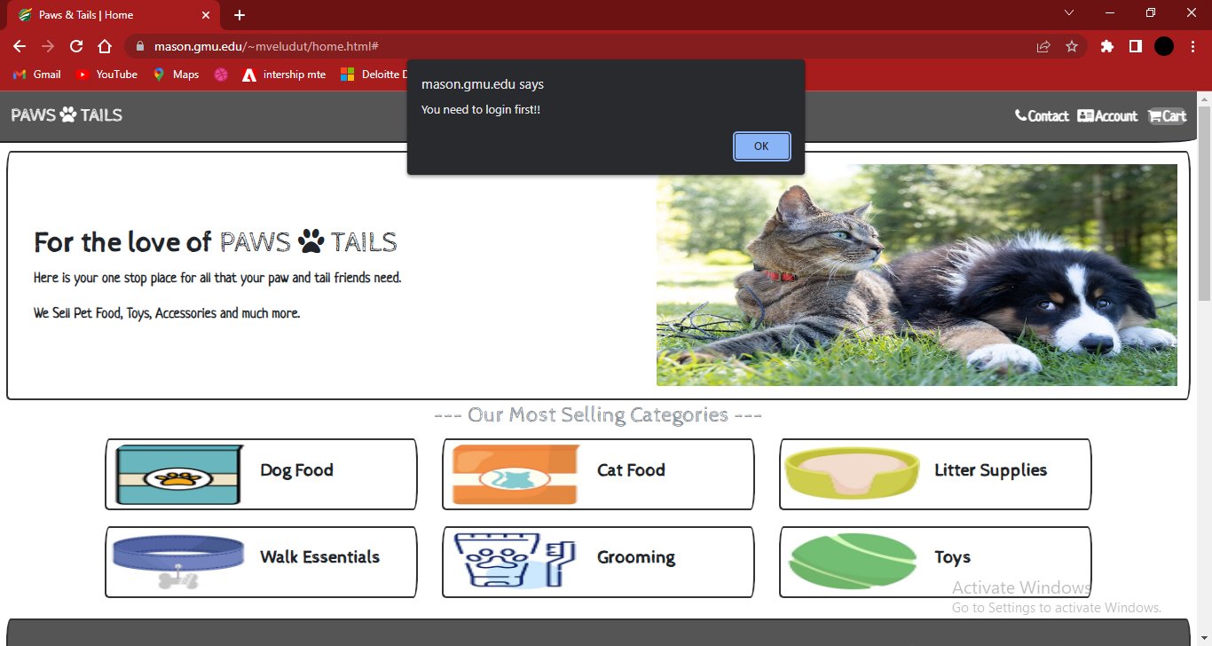
Usability heuristics and improvements cont.
Heuristic 3 Error prevention
We cannot go the cart Page unless the user is logged in, if the user tries to go to the cart page An error message is displayed "You need to login first". This is to prevent users who have not logged in from accessing the features which are exclusive to users and need user information to process.

Slide 11
Usability heuristics and improvements cont.
Heuristic 4 Real world match
There was a need to use terminology which are familiar with pet world. The very title of the website is an example of it. Further in the pages, usage of terms like “ Pet Parents”, “ Litter Supplies”, “ Treats & Chews”, ”Collars and leashes” etc. in place common e-commerce terminology of “ Pet Owners “, “ Toilet Cleaning “, “ Dog Snacks”, “ Dog belts” etc.
The usage of these lingo or terminology takes the website closer to its users and provides a factor of relatability and personalization to them.

Slide 12
Usability heuristics and improvements cont.
Heuristic 5 Flexibility and user efficiency
Shortcuts to certain pages and components have been provided throughout in various places.
The design of the homepage is structured in such a way that it provides quick access to offers, products, brands etc. without the user having to navigate their way in using the menu options provided in the nav bar.
Also, the footer at the bottom of every page also contains links for quick access.

Slide 13
SUMMARY
Our team worked on developing a user-friendly front-end application for an online pet store. We focused on incorporating clear affordance, signifiers, and an autocomplete feature in the FAQs to make the platform engaging and easy to navigate.
From lesson we learnt and adjusted using heuristics mentioned earlier to improve the visibility of components, consistency and standards, error prevention and the website.
One thing we discovered about UI principles through working on this project is the importance of considering the user's perspective and needs. By putting ourselves in the shoes of a pet owner, we were able to create a platform that caters to their needs and provides a convenient and efficient solution for purchasing pet products and accessing veterinary services.

